Slide 1
Java Basics
Concept of Object Oriented Programming (OOP),Java Overview
Encapsulation & more…
Java workshop training, August,2017.
Dr. Kishore Biswas (Forrest/柯修)
PhD. Artificial Intelligence—Natural Language Processing.
CanWay IT Training ®.

Slide 2
Contents.
1) Concept of Object Oriented Programming (OOP)
2) Java Overview
3) Encapsulation,
4) Inheritance,
5) Polymorphism
6) Exception handling mechanism and practice
7) Functional Programming in Java,
8) Generics and Annotations,
9) Principle for Usable Design & Usability Metrics.

Slide 3
1) Concept of Object Oriented Programming (OOP)

Slide 4
The Object-Oriented (OO) Programming Paradigm
Object-Oriented Programming (OOP) is one of the programming paradigms in computer science
OOP is the dominant modem programming paradigm
Object-Oriented Programming is well-known in the business world by the name of ‘Object Technology’

Slide 5
Programming Paradigms
Imperative Programming (FORTRAN, C, Pascal, …)
The most common programming paradigm
Functional Programming (LISP, …)
Logic Programming (Prolog)
(Declarative programming language; 宣告式語言)
Object-Oriented Programming
(Smalltalk, C++, Java, …)
Simply using C++/Java constructs does not automatically lead to well-organized Object-Oriented Programs.

Slide 6
Why OO Programming?
Better concepts and tools to model and represent the real world as closely as possible (including concurrency, e.g., in Windows GUI) => model of reality => behavior modeling
Better reusability & extensibility (inheritance) => reduce the time/cost of development
Enhanced maintainability & improved reliability – “Encapsulation” and “Information Hiding”
Object only accessible through the external interface
Internal implementation details are not visible outside
Localized changes to implementation of classes
Completeness: all required operations are defined
Independent testing and maintenance
Help writing good program more easily

Slide 7

Objects
An object is a thing.
Example of Objects
Object name
John
Mary
238-49-1357
Customer
Dog
Account
Object ‘type’

Slide 8
Classes
A class (e.g., Dog) is a kind of mold or template to create objects (e.g., Mary and DooDoo)
mold = 模型 = mould
An object is an instance of a class. The object belongs to that class
Instance-of
Mary
Dog
Dog
Dog
DooDoo
Dog

Slide 9
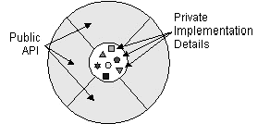
What Is an Object?
These real-world objects all have states and behaviors.
Definition: An object is a software bundle of variables and related methods (function).
A common visual representation of a software object.

Slide 10
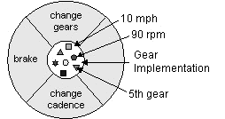
Example: Bicycle
The software bicycle's current state:
its speed is 10 mph,
its pedal cadence is 90 rpm, and
its current gear is the 5th gear.
The software bicycle would also have methods to
brake,
change the pedal cadence, and
change gears.

Slide 11
What Are Classes?
Definition:
A class is a blueprint or prototype
Defines the variables and methods common to all objects of a certain kind.
The Benefits of Classes
Reusability -- Software programmers use the same class, and the same code to create many objects.

Slide 12
Objects vs. Classes
Objects:
E.g., a real car.
Classes: or types
E.g., BMW-500
A Class is a blueprint or template of some objects
Object is an Instance of some class.

Slide 13
ADT --- Data Abstraction
An Abstract Data Type (ADT) is a user-defined data type that satisfies the following two conditions: (Encapsulation + Information Hiding)
The representation of, and operations on, objects of the type are defined in a single syntactic unit; also, other program units can create objects of the type.
The representation of objects of the type is hidden from the program units that use these objects, so the only operations (methods) possible are those provided in the type's definition which are known as interfaces.

Slide 14
Encapsulation
Hide the object's nucleus from other objects in the program.
The implementation details can change at any time without affecting other parts of the program.
It is an ideal representation of an object, but
For implementation or efficiency reasons, an object may wish to expose some of its variables or hide some of its methods.
Benefits:
Modularity
The source code for an object can be written and maintained independently of the source code for other objects.
Information hiding
An object has a public interface that other objects can use to communicate with it.

Slide 15
Classes in Java
A class -- is a template that describes the data and behavior associated with instances of that class.
An object -- instantiate a class you create an object.
An object is an instance of some class.
The data associated with a class or object is stored in variables.
The behavior associated with a class or object is implemented with methods.
Methods are similar to the functions or procedures in C.

Slide 16
Class Bicycle in Java
public class Bicycle {
private int speed = 10;
private int pedalCadence = 90;
private int currentGear = 5;
// a constructor!
public void brake() { /* ... */ }
public void changePedalCadence(int x) { /* */ }
public void changeGear(int x) { /* ... */ }
}
Not allowed in C++ Language

Slide 17
Class HelloWorld (Applet version)
inherit Applet
import java.applet.Applet; import java.awt.Graphics; public class HelloWorld extends Applet { public void paint(Graphics g) { g.drawString("Hello world!", 50, 25); } }

Slide 18
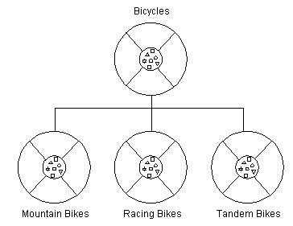
What Is Inheritance? (extends)
Subclasses inherit variables and methods from superclasses.
States:
Gear & Speed
Behaviors:
Brake & Accelerate
Subclasses can
Add variables and methods.
Override inherited methods.
Benefits:
Provide specialized behaviors
Reuse the code in the superclass
Abstract classes -- define "generic" behaviors.

Slide 19

Mankind extends Animal
public class Animal {
private int height = 0;
private int weight = 0;
public void talk( ) { System.out.println(“Arhh");}
}
public class Mankind extends Animal {
private int iq = 120;
public void talk( ) { System.out.println("Hello");}
}
Should be in different files
One Java file can only have one public class
Mankind is-a Animal

Slide 20
Mankind inherits Animal (C++)
class Animal {
int height = 0;
int weight = 0;
public:
void talk( ) { System.out.println("Won");}
};
class Mankind :public Animal {
private: int iq = 120;
public: void talk( ) { System.out.println("Hello");}
} ;
Classes can be in same file
In C++, ";" is required to terminate a class

Slide 21
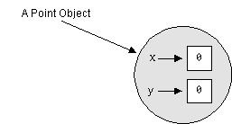
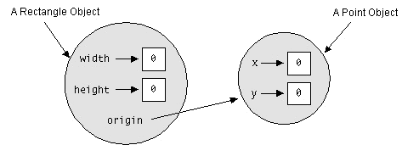
Rectangle Contains Point
public class Point {
private int x = 0;
private int y = 0;
}
public class Rectangle {
private int width = 0;
private int height = 0;
private Point origin = new Point();
}
Should be in different files
Car has-a Wheel

Slide 22
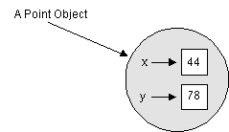
Point and it's constructor
public class Point {
private int x = 0;
private int y = 0;
// a constructor!
public Point(int xxx, int y) {
x = xxx;
this.y = y;
}
}
. . .
Point p = new Point(44,78);
this.y
this.x

Slide 23
Class may have many Constructors
public class Rectangle {
int width = 0;
int height = 0;
Point origin;
// four constructors
public Rectangle() { origin = new Point(0, 0); }
public Rectangle(Point p) { origin = p; }
public Rectangle(int w, int h) { this(new Point(0, 0), w, h); }
public Rectangle(Point p, int w, int h)
{ origin = p; width = w; height = h; }
// a method for moving the rectangle
public void move(int x, int y) { origin.x = x; origin.y = y; }
// a method for computing the area of the rectangle
public int area() { return width * height; }
}

Slide 24
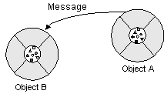
What Are Messages?
Message in an object.
Software objects interact and communicate with each other by sending messages to each other.
When object A wants object B to perform one of B's methods, object A sends a message to object B.

Slide 25
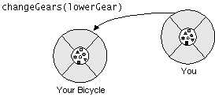
Messaging
Three components comprise a message:
The object to whom the message is addressed (Your Bicycle).
The name of the method to perform (changeGears).
Any parameters needed by the method (lowerGear).
Benefits:
Message passing supports all interactions between objects.
Messages can be sent and received between processes in the same machine or in different machines.
yourBicycle.changeGears(lowerGear)

Slide 26
Object-Oriented Technology
Object-Oriented Analysis (OOA)
Goal: Understand the domain
Object-Oriented Design (OOD)
Goal: Design a solution, a model of the domain in which the desired activities occur
Object-Oriented Programming (OOP)
Goal: Implement the solution
Note: A Good Design is 2/3 Before You Hit the Keyboard

Slide 27
STRUCTURED vs. OO PROGRAMMING
STRUCTURED PROGRAMMING:
MAIN PROGRAM
GLOBAL DATA
FUNCTION 1
FUNCTION 2
FUNCTION 3
FUNCTION 4
FUNCTION 5

Slide 28
Structured Programming
Using function
Function & program is divided into modules
Every module has its own data and function which can be called by other modules.

Slide 29
OBJECT ORIENTED PROGRAMMING
Object 1
Object 2
Data
Data
Function
Function
Object 3
Data
Function

Slide 30
OBJECT ORIENTED PROGRAMMING
Objects have both data and methods
Objects of the same class have the same data elements and methods
Objects send and receive messages to invoke actions
Key idea in object-oriented:
The real world can be accurately described as a collection of objects that interact.

Slide 31
Basic terminology
object
- usually a person, place or thing (a noun)
method
- an action performed by an object (a verb)
attribute
- description of objects in a class
class
- a category of similar objects (such as automobiles)
- does not hold any values of the object’s attributes

Slide 32
Example for attributes and methods
Attributes:
manufacturer’s name
model name
year made
color
number of doors
size of engine
etc.
Methods:
Define data items (specify manufacturer’s name, model, year, etc.)
Change a data item (color, engine, etc.)
Display data items
Calculate cost
etc.

Slide 33
Why OOP?
Save development time (and cost) by reusing code
once an object class is created it can be used in other applications
Easier debugging
classes can be tested independently
reused objects have already been tested

Slide 34
Design Principles of OOP
Four main design principles of Object-Oriented Programming(OOP):
Encapsulation
Abstraction
Polymorphism
Inheritance

Slide 35

Encapsulation
Also known as data hiding
Only object’s methods can modify information in the object.
Analogy:
ATM machine can only update accounts of one person or object only.

Slide 36
Abstraction
Focus only on the important facts about the problem at hand
to design, produce, and describe so that it can be easily used without knowing the details of how it works.
Analogy:
When you drive a car, you don’t have to know how the gasoline and air are mixed and ignited.
Instead you only have to know how to use the controls.
Draw map

Slide 37
Polymorphism
the same word or phrase can mean different things in different contexts
Analogy:
In English, bank can mean side of a river or a place to put money
move -

Slide 38
Function Overloading
The operation of one function depends on the argument passed to it.
Example: Fly(), Fly(low), Fly(150)

Slide 39
Inheritance
Inheritance—a way of organizing classes
Term comes from inheritance of traits like eye color, hair color, and so on.
Classes with properties in common can be grouped so that their common properties are only defined once.
Superclass – inherit its attributes & methods to the subclass(es).
Subclass – can inherit all its superclass attributes & methods besides having its own unique attributes & methods.

Slide 40
An Inheritance Hierarchy
Superclass
Vehicle
Subclasses
Automobile
Motorcycle
Bus
Sedan
Sports Car
Luxury Bus
School Bus
What properties does each vehicle inherit from the types of vehicles above it in the diagram?

Slide 41
Object-Oriented Programming Languages
• Pure OO Languages
Smalltalk, Eiffel, Actor, Java
• Hybrid OO Languages
C++, Objective-C, Object-Pascal

Slide 42
Review: Introduction to Object Orientation
What are the four basic principles of object orientation? Provide a brief description of each.
What is an Object and what is a Class? What is the difference between them?
What is an Attribute?
What is an Operation?
What is inheritance?
What is polymorphism?
Describe the strengths of object orientation.

Slide 43
Review: Introduction to Object Orientation
State 2 differences between functional programming and OOP.
What are the four basic principles of object orientation? Provide a brief description of each.
What is an Object and what is a Class? What is the difference between them?
What is an Attribute?
What is an Operation?
Describe the strengths of object orientation.

Slide 44
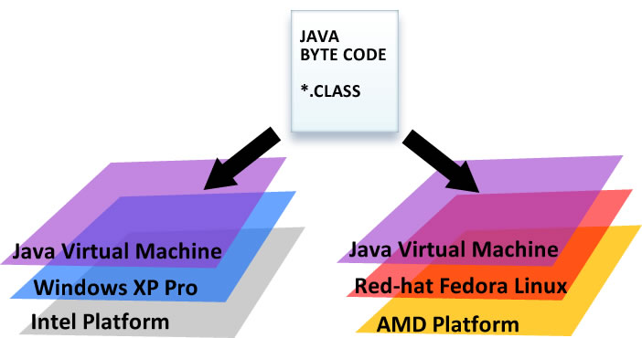
Architecture Neutral
Java Code is compiled to .class files which are interpreted as bytecode by the JVM. (.NET does this too; only you’re trapped in an MS op system.)
JIT compilers like HotSpot are very fast – little difference between in performance between machine-binary and interpreted byte-code.
Notes:
44

Slide 45
Java8 is OO “AND” Functional
Java is Object-Oriented. Java code must be encapsulated inside a class . No procedural programming; and no spaghetti code.
Java8 is now functional and allows for lambdas, streams, and parallel programming.
Notes:
45

Slide 46
Implementation Independence
A java int is ALWAYS 32bits; regardless of operating system.
A java long is ALWAYS 64bits.
hashcode() will always be consistent.
Serialization is versioned and consistent.
The same is not true of C/C++.
Notes:
46

Slide 47
No Pointers
There are no pointers in Java
Instead Java uses references; which for all intents and purposes, behave like pointers.
C++ is like driving a manual transmission car, Java is like driving an automatic transmission car, and python is like sitting in an uber cab.
Notes:
47

Slide 48
Version numbers in Java
Jdk1.5 == Java 5.0
Jdk1.6 == Java 6.0
Jdk1.7 == Java 7.0
Jdk1.8 == Java 8.0
Notes:
48

Slide 49
Wrapper Classes
Every primitive has a corresponding Wrapper class.
For example; double has Double, int has Integer, boolean has Boolean, char has Character, etc.
These wrapper classes can be very useful when storing values in collections which require you to use objects, and forbid the use of primitives.
Useful for Streams.
Notes:
49
Pull up java.lang.* from the api
http://download.oracle.com/javase/6/docs/api/
49

Slide 50
Object heirarchies
You can also see the API online. Determine the version you're using by typing> java –version
http://docs.oracle.com/javase/8/docs/api/
Class hierarchies.
The Object class is the grand-daddy of ALL java classes.
Every class inherits methods from Object.
And from all its other ancestry.
Even if you create a class that extends no other classes, you still extend Object by default.
Notes:
50
Pull up the api
http://download.oracle.com/javase/6/docs/api/
Show java.lang.*
50

Slide 51


Class Object
A blueprint is to a house as a class is to an object
Class = Blueprint
Notes:
51

Slide 52


Lambda Function
Functions are now first-class citizens
Store a method in a Lambda for deferred execution.
Notes:
52

Slide 53
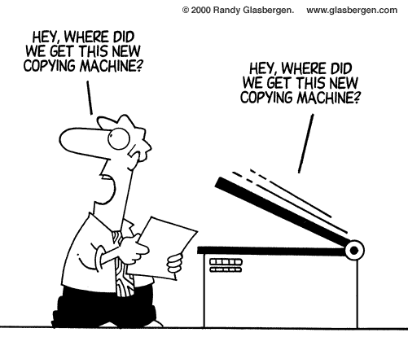

pass by value pass by reference
Action: Tell my accountant how much I intend to spend on a new car.
Change in bank account: no change.
Action: Swipe debit card and enter pin at the Bently dealership.
Change in bank account: -125k.
Notes:
53
53

Slide 54
2) Java Overveiw

Slide 55
Why Java ?
Portable
Easy to learn

Slide 56
JVM
JVM stands for Java Virtual Machine
Unlike other languages, Java “executables” are executed on a CPU that does not exist.

Slide 57
Platform Dependent
gcc
myprog.exe
myprog.c
machine code
C source code
OS/Hardware
Platform Independent
javac
myprog.class
myprog.java
bytecode
Java source code
JVM
OS/Hardware

Slide 58
Primitive types
int 4 bytes
short 2 bytes
long 8 bytes
byte 1 byte
float 4 bytes
double 8 bytes
char Unicode encoding (2 bytes)
boolean {true,false}
Behaviors is exactly as in C++
Note:
Primitive type
always begin
with lower-case

Slide 59
Primitive types - cont.
Constants
37 integer
37.2 float
42F float
0754 integer (octal)
0xfe integer (hexadecimal)

Slide 60
Wrappers
Java provides Objects which wrap primitive types and supply methods.
Example:
Integer n = new Integer(“4”);
int m = n.intValue();
Read more about Integer in JDK Documentation

Slide 61
Hello World
Hello.java
class Hello {
public static void main(String[] args) {
System.out.println(“Hello World !!!”); }
}
C:\javac Hello.java
C:\java Hello
( compilation creates Hello.class )
(Execution on the local JVM)

Slide 62
More sophisticated
class Kyle {
private boolean kennyIsAlive_;
public Kyle() { kennyIsAlive_ = true; }
public Kyle(Kyle aKyle) {
kennyIsAlive_ = aKyle.kennyIsAlive_;
}
public String theyKilledKenny() {
if (kennyIsAlive_) {
kennyIsAlive_ = false;
return “You bastards !!!”;
} else {
return “?”;
}
}
public static void main(String[] args) {
Kyle k = new Kyle();
String s = k.theyKilledKenny();
System.out.println(“Kyle: “ + s);
}
}
Default C’tor
Copy C’tor

Slide 63
Results
javac Kyle.java ( to compile )
java Kyle ( to execute )
Kyle: You bastards !!!

Slide 64
Arrays
Array is an object
Array size is fixed
Animal[] arr; // nothing yet …
arr = new Animal[4]; // only array of pointers
for(int i=0 ; i < arr.length ; i++) {
arr[i] = new Animal();
// now we have a complete array

Slide 65
Arrays - Multidimensional
In C++
Animal arr[2][2]
Is:
In Java
Animal[][] arr=
new Animal[2][2]
What is the type of
the object here ?

Slide 66
Static - [1/4]
Member data - Same data is used for all the instances (objects) of some Class.
Assignment performed
on the first access to the
Class.
Only one instance of ‘x’
exists in memory
Class A {
public int y = 0;
public static int x_ = 1;
};
A a = new A();
A b = new A();
System.out.println(b.x_);
a.x_ = 5;
System.out.println(b.x_);
A.x_ = 10;
System.out.println(b.x_);
a
b
Output:
1
5
10
0
0
y
y
1
A.x_

Slide 67
Static - [2/4]
Member function
Static member function can access only static members
Static member function can be called without an instance.
Class TeaPot {
private static int numOfTP = 0;
private Color myColor_;
public TeaPot(Color c) {
myColor_ = c;
numOfTP++;
}
public static int howManyTeaPots()
{ return numOfTP; }
// error :
public static Color getColor()
{ return myColor_; }
}

Slide 68
Static - [2/4] cont.
Usage:
TeaPot tp1 = new TeaPot(Color.RED);
TeaPot tp2 = new TeaPot(Color.GREEN);
System.out.println(“We have “ + TeaPot.howManyTeaPots()+ “Tea Pots”);

Slide 69
Static - [3/4]
Block
Code that is executed in the first reference to the class.
Several static blocks can exist in the same class ( Execution order is by the appearance order in the class definition ).
Only static members can be accessed.
class RandomGenerator {
private static int seed_;
static {
int t = System.getTime() % 100;
seed_ = System.getTime();
while(t-- > 0)
seed_ = getNextNumber(seed_);
}
}
}

Slide 70
String is an Object
Constant strings as in C, does not exist
The function call foo(“Hello”) creates a String object, containing “Hello”, and passes reference to it to foo.
There is no point in writing :
The String object is a constant. It can’t be changed using a reference to it.
String s = new String(“Hello”);

Slide 71
Flow control
Basically, it is exactly like c/c++.
do/while
switch
int i=5;
do {
// act1
i--;
} while(i!=0);
if/else
char c=IN.getChar();
switch(c) {
case ‘a’:
case ‘b’:
// act1
break;
default:
// act2
}
If(x==4) {
// act1
} else {
// act2
}
for
int j;
for(int i=0;i<=9;i++)
{
j+=i;
}

Slide 72
Packages
Java code has hierarchical structure.
The environment variable CLASSPATH contains the directory names of the roots.
Every Object belongs to a package ( ‘package’ keyword)
Object full name contains the name full name of the package containing it.

Slide 73
Access Control
public member (function/data)
Can be called/modified from outside.
protected
Can be called/modified from derived classes
private
Can be called/modified only from the current class
default ( if no access modifier stated )
Usually referred to as “Friendly”.
Can be called/modified/instantiated from the same package.

Slide 74
Inheritance
class Base {
Base(){}
Base(int i) {}
protected void foo() {…}
}
class Derived extends Base {
Derived() {}
protected void foo() {…}
Derived(int i) {
super(i);
…
super.foo();
}
}
Base
Derived
As opposed to C++, it is possible to inherit only from ONE class.
Pros avoids many potential problems and bugs.
Cons might cause code replication

Slide 75
Polymorphism
Inheritance creates an “is a” relation:
For example, if B inherits from A, than we say that “B is also an A”.
Implications are:
access rights (Java forbids reducing access rights) - derived class can receive all the messages that the base class can.
behavior
precondition and postcondition

Slide 76
Inheritance (2)
In Java, all methods are virtual :
class Base {
void foo() {
System.out.println(“Base”);
}
}
class Derived extends Base {
void foo() {
System.out.println(“Derived”);
}
}
public class Test {
public static void main(String[] args) {
Base b = new Derived();
b.foo(); // Derived.foo() will be activated
}
}

Slide 77
Inheritance (3) - Optional
class classC extends classB {
classC(int arg1, int arg2){
this(arg1);
System.out.println("In classC(int arg1, int arg2)");
}
classC(int arg1){
super(arg1);
System.out.println("In classC(int arg1)");
}
}
class classB extends classA {
classB(int arg1){
super(arg1);
System.out.println("In classB(int arg1)");
}
classB(){
System.out.println("In classB()");
}
}

Slide 78
Inheritance (3) - Optional
class classA {
classA(int arg1){
System.out.println("In classA(int arg1)");
}
classA(){
System.out.println("In classA()");
}
}
class classB extends classA {
classB(int arg1, int arg2){
this(arg1);
System.out.println("In classB(int arg1, int arg2)");
}
classB(int arg1){
super(arg1);
System.out.println("In classB(int arg1)");
} class B() { System.out.println("In classB()"); }
}

Slide 79
Abstract
abstract member function, means that the function does not have an implementation.
abstract class, is class that can not be instantiated.
AbstractTest.java:6: class AbstractTest is an abstract class.
It can't be instantiated.
new AbstractTest();
^
1 error
NOTE:
An abstract class is not required to have an abstract method in it.
But any class that has an abstract method in it or that does
not provide an implementation for any abstract methods declared
in its superclasses must be declared as an abstract class.
Example

Slide 80
Abstract - Example
package java.lang;
public abstract class Shape {
public abstract void draw();
public void move(int x, int y) {
setColor(BackGroundColor);
draw();
setCenter(x,y);
setColor(ForeGroundColor);
draw();
}
}
package java.lang;
public class Circle extends Shape {
public void draw() {
// draw the circle ...
}
}

Slide 81
Interface
Interfaces are useful for the following:
Capturing similarities among unrelated classes without artificially forcing a class relationship.
Declaring methods that one or more classes are expected to implement.
Revealing an object's programming interface without revealing its class.

Slide 82
Interface
abstract “class”
Helps defining a “usage contract” between classes
All methods are public
Java’s compensation for removing the multiple inheritance. You can “inherit” as many interfaces as you want.
Example
* - The correct term is “to implement”
an interface

Slide 83
Interface
interface IChef {
void cook(Food food);
}
interface BabyKicker {
void kickTheBaby(Baby);
}
interface SouthParkCharacter {
void curse();
}
class Chef implements IChef, SouthParkCharacter {
// overridden methods MUST be public
// can you tell why ?
public void curse() { … }
public void cook(Food f) { … }
}
* access rights (Java forbids reducing of access rights)

Slide 84
When to use an interface ?
Perfect tool for encapsulating the classes inner structure. Only the interface will be exposed

Slide 85
Collections
Collection/container
object that groups multiple elements
used to store, retrieve, manipulate, communicate aggregate data
Iterator - object used for traversing a collection and selectively remove elements
Generics – implementation is parametric in the type of elements

Slide 86
Java Collection Framework
Goal: Implement reusable data-structures and functionality
Collection interfaces - manipulate collections independently of representation details
Collection implementations - reusable data structures
List<String> list = new ArrayList<String>(c);
Algorithms - reusable functionality
computations on objects that implement collection interfaces
e.g., searching, sorting
polymorphic: the same method can be used on many different implementations of the appropriate collection interface

Slide 87
Collection Interfaces
Collection
Map
Set
List
Queue
Sorted Map
SortedSet

Slide 88
Collection Interface
Basic Operations
int size();
boolean isEmpty();
boolean contains(Object element);
boolean add(E element);
boolean remove(Object element);
Iterator iterator();
Bulk Operations
boolean containsAll(Collection<?> c);
boolean addAll(Collection<? extends E> c);
boolean removeAll(Collection<?> c);
boolean retainAll(Collection<?> c);
void clear();
Array Operations
Object[] toArray(); <T> T[] toArray(T[] a); }

Slide 89
General Purpose Implementations
Collection
Map
Set
List
Queue
Sorted Map
SortedSet
HashSet
TreeSet
ArrayList
LinkedList
TreeMap
HashMap
List<String> list1 = new ArrayList<String>(c);
List<String> list2 = new LinkedList<String>(c);

Slide 90
final
final member data Constant member
final member function The method can’t be overridden.
final class ‘Base’ is final, thus it can’t be extended
final class Base {
final int i=5;
final void foo() {
i=10;
//what will the compiler say about this?
}
}
class Derived extends Base { // Error
// another foo ...
void foo() {
}
}
(String class is final)

Slide 91
final
Derived.java:6: Can't subclass final classes: class Base
class class Derived extends Base {
^
1 error
final class Base {
final int i=5;
final void foo() {
i=10;
}
}
class Derived extends Base { // Error
// another foo ...
void foo() {
}
}

Slide 92
IO - Introduction
Definition
Stream is a flow of data
characters read from a file
bytes written to the network
…
Philosophy
All streams in the world are basically the same.
Streams can be divided (as the name “IO” suggests) to Input and Output streams.
Implementation
Incoming flow of data (characters) implements “Reader” (InputStream for bytes)
Outgoing flow of data (characters) implements “Writer” (OutputStream for bytes –eg. Images, sounds etc.)

Slide 93
Exception - What is it and why do I care?
Definition: An exception is an event that occurs during the execution of a program that disrupts the normal flow of instructions.
Exception is an Object
Exception class must be descendent of Throwable.

Slide 94
Exception - What is it and why do I care?(2)
By using exceptions to manage errors, Java programs have the following advantages over traditional error management techniques:
1: Separating Error Handling Code from "Regular" Code 2: Propagating Errors Up the Call Stack 3: Grouping Error Types and Error Differentiation

Slide 95
Separating Error Handling Code from "Regular" Code (1)
readFile {
open the file;
determine its size;
allocate that much memory;
read the file into memory;
close the file;
}

Slide 96
Separating Error Handling Code from "Regular" Code (2)
errorCodeType readFile {
initialize errorCode = 0;
open the file;
if (theFileIsOpen) {
determine the length of the file;
if (gotTheFileLength) {
allocate that much memory;
if (gotEnoughMemory) {
read the file into memory;
if (readFailed) {
errorCode = -1;
}
} else {
errorCode = -2;
}
} else {
errorCode = -3;
}
close the file;
if (theFileDidntClose && errorCode == 0) {
errorCode = -4;
} else {
errorCode = errorCode and -4;
}
} else {
errorCode = -5;
}
return errorCode;
}

Slide 97
1: Separating Error Handling Code from "Regular" Code (3)
readFile {
try {
open the file;
determine its size;
allocate that much memory;
read the file into memory;
close the file;
} catch (fileOpenFailed) {
doSomething;
} catch (sizeDeterminationFailed) {
doSomething;
} catch (memoryAllocationFailed) {
doSomething;
} catch (readFailed) {
doSomething;
} catch (fileCloseFailed) {
doSomething;
}
}

Slide 98
2: Propagating Errors Up the Call Stack
method1 {
try {
call method2;
} catch (exception) {
doErrorProcessing;
}
}
method2 throws exception {
call method3;
}
method3 throws exception {
call readFile;
}

Slide 99
Objects
(Implementation in Java)
class Time { private int hour, minute; public Time (int h, int m) { hour = h; minute = m; } public void addMinutes (int m) { int totalMinutes = ((60*hour) + minute + m) % (24*60); if (totalMinutes<0) totalMinutes = totalMinutes + (24*60); hour = totalMinutes / 60; minute = totalMinutes % 60; }
}
this is partial…

Slide 100


“Intrinsic Power” vs. “Effective Power”
This progression is not a matter of “intrinsic power”
Anything you can do with a minimally capable computer language, you can theoretically do with any other minimally capable computer language
But that is like saying a shovel is theoretically as capable as a tractor. In practice, using a shovel might make things very hard…

Slide 101
Objects
class
Time
inTime
hour
minute
void addMinutes( int m )
Attributes: hour = 8 minute = 30 Methods: void addMinutes(int m)
outTime
Attributes: hour = 17 minute = 35 Methods: void addMinutes(int m)
objects

Slide 102
Classes and Objects
A class is a prototype for creating objects
When we write a program in an object-oriented language like Java, we define classes, which in turn are used to create objects
A class has a constructor for creating objects

Slide 103
A Simple Class, called “Time” (partial)
class Time { private int hour, minute; public Time (int h, int m) { hour = h; minute = m; } public void addMinutes (int m) { int totalMinutes = ((60*hour) + minute + m) % (24*60); if (totalMinutes<0) totalMinutes = totalMinutes + (24*60); hour = totalMinutes / 60; minute = totalMinutes % 60; }
}
constructor for Time

Slide 104
Definition of an “Object”
An object is a computational entity that:
Encapsulates some state
Is able to perform actions, or methods, on this state
Communicates with other objects via message passing

Slide 105
1) Encapsulates some state
Like a record in Pascal, it has a set of variables (of possibly different types) that describe an object’s state
These variables are sometimes called an object’s attributes (or fields, or instance variables, or datamembers, or …)

Slide 106
Pascal Example: Represent a Time
type TimeTYPE = record Hour: 1..23;
Minute: 0..59;
end;
var inToWork, outFromWork: TimeTYPE;

Slide 107
Java Example: Represent a Time
attributes of Time
class Time { private int hour, minute;
public Time (int h, int m) { hour = h; minute = m; } …
}
constructor for Time
Time inToWork = new Time(8, 30); Time outFromWork = new Time(17, 35);

Slide 108
Objects
class
Time
inToWork
hour
minute
void addMinutes( int m )
Attributes: hour = 8 minute = 30 Methods: void addMinutes(int m)
outFromWork
Attributes: hour = 17 minute = 35 Methods: void addMinutes(int m)
objects

Slide 109
2) Is able to perform actions, or methods, on this state
More than a Pascal record!
An object can also include a group of procedures/functions that carry out actions
class Time { private int hour, minute; public Time (int h, int m) { hour = h; minute = m; } public void addMinutes (int m) { int totalMinutes = ((60*hour) + minute + m) % (24*60); if (totalMinutes<0) totalMinutes = totalMinutes + (24*60); hour = totalMinutes / 60; minute = totalMinutes % 60; }
}
a method of Time

Slide 110
3) Communicates with other objects via message passing
Sends messages to objects, triggering methods in those objects
void

Slide 111
Example of Object Creation and Message Passing
bill
Attributes: … Methods: …

Slide 112
Example of Object Creation and Message Passing
In one of bill’s methods, the following code appears: Time inToWork = new Time(8, 30); inToWork.addMinutes(15);
bill
Attributes: … Methods: …

Slide 113
Example of Object Creation and Message Passing
In one of bill’s methods, the following code appears: Time inToWork = new Time(8, 30); inToWork.addMinutes(15);
inToWork
Attributes: hour = 8 minute = 30 Methods: void addMinutes(int m)
bill
Attributes: … Methods: …

Slide 114
Example of Object Creation and Message Passing
In one of bill’s methods, the following code appears: Time inToWork = new Time(8, 30); inToWork.addMinutes(15);
inToWork
inToWork.addMinutes(15)
Attributes: hour = 8 minute = 30 Methods: void addMinutes(int m)
bill
Attributes: … Methods: …

Slide 115
Example of Object Creation and Message Passing
In one of bill’s methods, the following code appears: Time inToWork = new Time(8, 30); inToWork.addMinutes(15);
inToWork
Attributes: hour = 8 minute = 45 Methods: void addMinutes(int m)
bill
Attributes: … Methods: …

Slide 116
Structure of a Class Definition
class name {
declarations
constructor definition(s)
method definitions
}
attributes and symbolic constants
how to create and initialize objects
how to manipulate the state of objects
These parts of a class can actually be in any order

Slide 117
History of Object-Oriented Programming
Started out for simulation of complex man-machine systems, but was soon realized that it was suitable for all complex programming projects
SIMULA I (1962-65) and Simula 67 (1967) were the first two object-oriented languages
Developed at the Norwegian Computing Center, Oslo, Norway by Ole-Johan Dahl and Kristen Nygaard
Simula 67 introduced most of the key concepts of object-oriented programming: objects and classes, subclasses (“inheritance”), virtual procedures

Slide 118
The Ideas Spread
Alan Kay, Adele Goldberg and colleagues at Xerox PARC extend the ideas of Simula in developing Smalltalk (1970’s)
Kay coins the term “object oriented”
Smalltalk is first fully object oriented language
Grasps that this is a new programming paradigm
Integration of graphical user interfaces and interactive program execution
Bjarne Stroustrup develops C++ (1980’s)
Brings object oriented concepts into the C programming language

Slide 119
Other Object Oriented Languages
Eiffel (B. Meyer)
CLOS (D. Bobrow, G. Kiczales)
SELF (D. Ungar et al.)
Java (J. Gosling et al.)
BETA (B. Bruun-Kristensen, O. Lehrmann Madsen, B. Møller-Pedersen, K. Nygaard)
Other languages add object dialects, such as TurboPascal
…

Slide 120
REVIEW: Definition of an “Object”
An object is a computational entity that:
Encapsulates some state
Is able to perform actions, or methods, on this state
Communicates with other objects via message passing

Slide 121
Encapsulation
The main point is that by thinking of the system as composed of independent objects, we keep sub-parts really independent
They communicate only through well-defined message passing
Different groups of programmers can work on different parts of the project, just making sure they comply with an interface
It is possible to build larger systems with less effort

Slide 122
Advantages
Building the system as a group of interacting objects:
Allows extreme modularity between pieces of the system
May better match the way we (humans) think about the problem
Avoids recoding, increases code-reuse

Slide 123
But there’s more…
Classes can be arranged in a hierarchy
Subclasses inherit attributes and methods from their parent classes
This allows us to organize classes, and to avoid rewriting code – new classes extend old classes, with little extra work!
Allows for large, structured definitions

Slide 124
Example of Class Inheritance
Object
toString( )
equals( Object obj )
getClass( )
Objects made from this class, for example, have all the attributes and methods of the classes above them, all the way up the tree
extends
extends
Shape
Time
color
borderWidth
hour
minute
Color getColor( )
void setBorderWidth( int m )
void addMinutes( int m )
extends
extends
extends
Rectangle
Circle
Triangle
length
width
radius
base
height
int computeArea( )
int computeArea( )
int computeArea( )

Slide 125
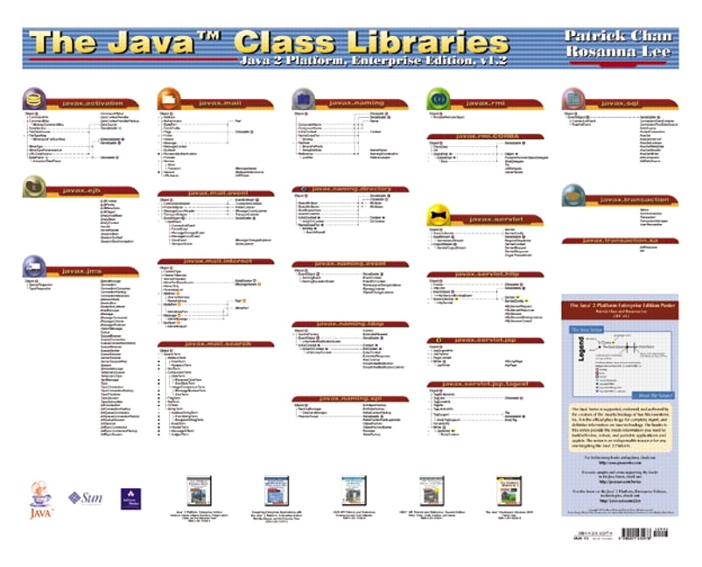
Java Class Hierarchy

Slide 126
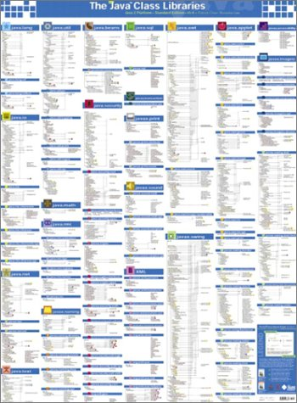
Java Class Hierarchy, another view

Slide 127
Polymorphism
An object has “multiple identities”, based on its class inheritance tree
It can be used in different ways

Slide 128
Polymorphism
An object has “multiple identities”, based on its class inheritance tree
It can be used in different ways
A Circle is-a Shape is-a Object

Slide 129
Polymorphism
An object has “multiple identities”, based on its class inheritance tree
It can be used in different ways
A Circle is-a Shape is-a Object
Object
Shape
Circle
A Circle object really has 3 parts

Slide 130
How Objects are Created
Circle c = new Circle( );

Slide 131
How Objects are Created
Circle c = new Circle( );
1.
Object
Shape
Circle
c
Execution Time

Slide 132
How Objects are Created
Circle c = new Circle( );
1.
2.
Object
Object
Shape
Shape
Circle
Circle
c
c
Execution Time

Slide 133
How Objects are Created
Circle c = new Circle( );
1.
2.
3.
Object
Object
Object
Shape
Shape
Shape
Circle
Circle
Circle
c
c
c
Execution Time

Slide 134
Three Common Uses for Polymorphism
Using Polymorphism in Arrays
Using Polymorphism for Method Arguments
Using Polymorphism for Method Return Type

Slide 135
1) Using Polymorphism in Arrays
We can declare an array to be filled with “Shape” objects, then put in Rectangles, Circles, or Triangles

Slide 136
1) Using Polymorphism in Arrays
We can declare an array to be filled with “Shape” objects, then put in Rectangles, Circles, or Triangles
samples (an array of Shape objects)
[0]
[1]
[2]

Slide 137
1) Using Polymorphism in Arrays
We can declare an array to be filled with “Shape” objects, then put in Rectangles, Circles, or Triangles
firstShape
secondShape
thirdShape
Attributes: length = 17 width = 35 Methods: int computeArea( )
Attributes: radius = 11 Methods: int computeArea( )
Attributes: base = 15 height = 7 Methods: int computeArea( )
[2]
samples (an array of Shape objects)
[0]
[1]
[2]

Slide 138
1) Using Polymorphism in Arrays
We can declare an array to be filled with “Shape” objects, then put in Rectangles, Circles, or Triangles
firstShape
secondShape
thirdShape
Attributes: length = 17 width = 35 Methods: int computeArea( )
Attributes: radius = 11 Methods: int computeArea( )
Attributes: base = 15 height = 7 Methods: int computeArea( )
[2]
Triangle
Rectangle
Circle
samples (an array of Shape objects)
[0]
[1]
[2]

Slide 139
2) Using Polymorphism for Method Arguments
We can create a procedure that has Shape as the type of its argument, then use it for objects of type Rectangle, Circle, and Triangle
public int calculatePaint (Shape myFigure) {
final int PRICE = 5; int totalCost = PRICE * myFigure.computeArea( ); return totalCost; }
The actual definition of computeArea( ) is known only at runtime, not compile time – this is “dynamic binding”

Slide 140
2) Using Polymorphism for Method Arguments
Polymorphism give us a powerful way of writing code that can handle multiple types of objects, in a unified way
public int calculatePaint (Shape myFigure) {
final int PRICE = 5; int totalCost = PRICE * myFigure.computeArea( ); return totalCost; }
To do this, we need to declare in Shape’s class definition that its subclasses will define the method computeArea( )

Slide 141
3) Using Polymorphism for Method Return Type
We can write general code, leaving the type of object to be decided at runtime
public Shape createPicture ( ) {
/* Read in choice from user */ System.out.println(“1 for rectangle, ” + “2 for circle, 3 for triangle:”); SimpleInput sp = new SimpleInput(System.in); int i = sp.readInt( ); if ( i == 1 ) return new Rectangle(17, 35); if ( i == 2 ) return new Circle(11); if ( i == 3 ) return new Triangle(15, 7); }

Slide 142
Java Convinced Me to Start Teaching Object-Oriented in Intro to CS
Java is Object-Oriented from the Ground Up
Java has the elegance that comes from being designed after other OO languages had been in use for many years
Java has strong type checking
Java handles its own memory allocation
Java’s syntax is “standard” (similar to C and C++)
Java is a good teaching language, but it (or something close) will also be seen by students in industry

Slide 143
Object-Oriented Programming in Industry
Large projects are routinely programmed using object-oriented languages nowadays
MS-Windows and applications in MS-Office – all developed using object-oriented languages
This is the world into which our students are graduating…

Slide 144
3) Encapsulation

Slide 145
OOP in a Nutshell:
A program models a world of interacting objects
Objects create other objects and “send messages” to each other (in Java, call each other’s methods)
Each object belongs to a class; a class defines properties of its objects
A class implements an ADT; the data type of an object is its class
Programmers write classes (and reuse existing classes)

Slide 146
OOP
Encapsulation
Abstraction
Inheritance
Polymorphism

Slide 147
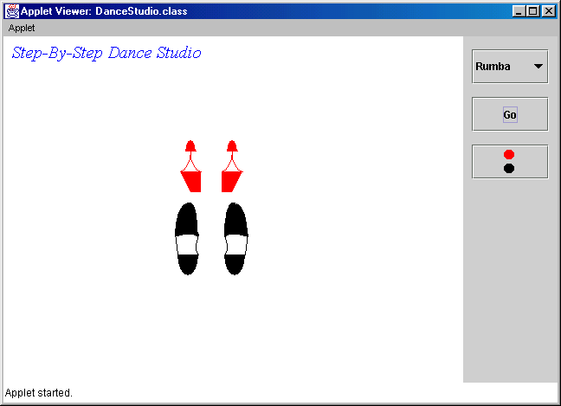
Case Study: Dance Studio

Slide 148
Quiz:
How many classes we wrote
for this applet?
A. 1
B. 2
C. 5
D. 10
E. 17

Slide 150
Good news: The classes are fairly short
In OOP, the number of classes is not considered a problem

Slide 151
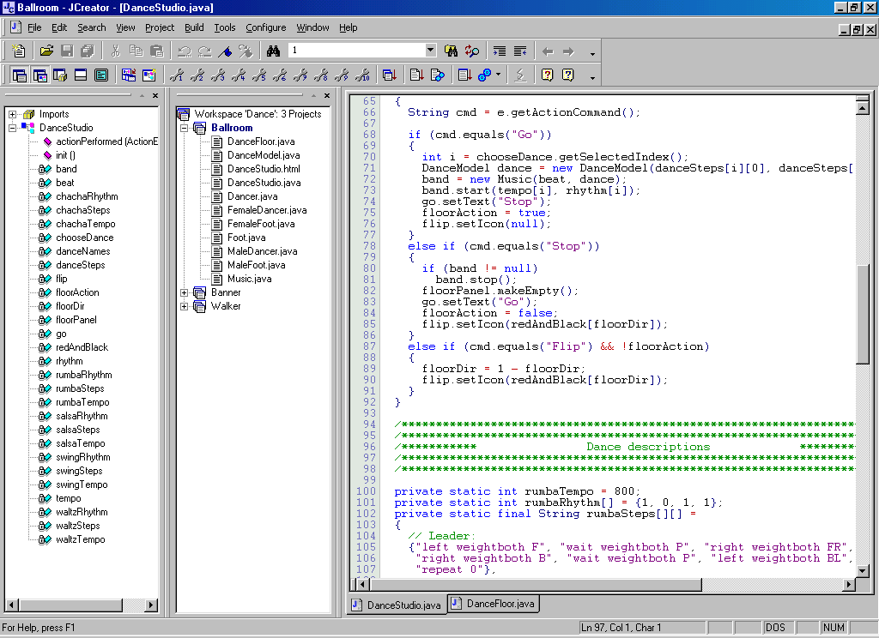
In a project with 10 classes we need an IDE...

Slide 152

Abstraction
Encapsulation
Abstraction
Inheritance
Polymorphism
Abstraction means ignoring irrelevant features, properties, or functions and emphasizing the relevant ones...
“Relevant” to what?
... relevant to the given project (with an eye to future reuse in similar projects).

Slide 153
Abstraction

Slide 154
Encapsulation
Encapsulation
Abstraction
Inheritance
Polymorphism
Encapsulation means that all data members (fields) of a class are declared private. Some methods may be private, too.
The class interacts with other classes (called the clients of this class) only through the class’s constructors and public methods. Constructors and public methods of a class serve as the interface to class’s clients.

Slide 155
Encapsulation

Slide 156
public abstract class Foot
{
private static final int footWidth = 24;
private boolean amLeft;
private int myX, myY;
private int myDir;
private boolean myWeight;
// Constructor:
protected Foot(String side, int x, int y, int dir)
{
amLeft = side.equals("left");
myX = x;
myY = y;
myDir = dir;
myWeight = true;
}
Continued È
All fields are private

Slide 157
Encapsulation ensures that structural changes remain local
Changes in the code create software maintenance problems
Usually, the structure of a class (as defined by its fields) changes more often than the class’s constructors and methods
Encapsulation ensures that when fields change, no changes are needed in other classes (a principle known as “locality”)

Slide 158
True or False? Abstraction and encapsulation are helpful for the following:
¨ Team development ________
¨ Reusable software ________
¨ GUI programming ________
¨ Easier program maintenance ________

Slide 159
Answer:
T
þ Team development ________
þ Reusable software ________
¨ GUI programming ________
þ Easier program maintenance ________
T
F
(True if you are working on system packages, such as Swing)
T

